Slide 1
Modern Workplace

Slide 2
Enabling Digital Transformation
Modern Workplace
Business Applications
Empower employees
Engage customers
Optimize operations
Transform products
Applications & Infrastructure
Data & AI
Notes:
Over the next few days we will be getting everyone up to speed on all our offerings to help organizations achieve their Digital Transformation goals.
Digital Transformation means many things to many people
Better tools and data to help Empower employees
Improved experiences and communications to help Engage customers
Optimize operations to allow organizations to scale
Leverage tools and technology to help transform products and services being offered to the customers.

Slide 3
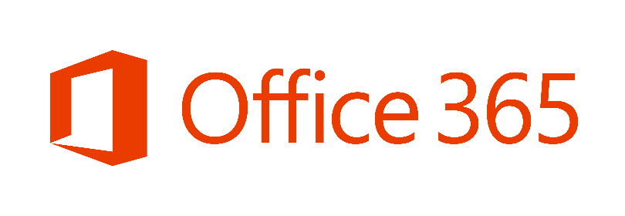
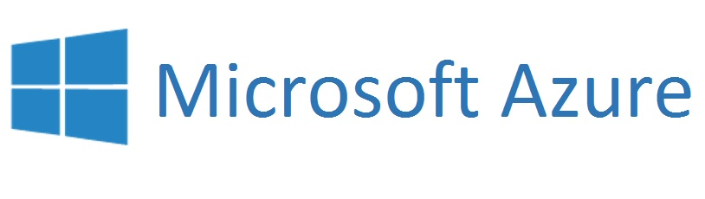

Modern Workplace Consumption Economics
System Integrator Experience (Sell, Build, Deploy)
ISV Developer Experience (Build, Sell, Deploy)
Opportunity to achieve cross consumption
Notes:
Modern Workplace Consumption Economics is our opportunity to work together to help us exceed our goals of driving consumption
We are here together as a mix of focus areas.
Some come from the system integrator experience
Some come from the developer experience supporting ISV’s
The system integrators help to lay the foundation
The ISV’s help to extend the foundation to help organization achieve more in line with their business rules and intellectual property.
By working together

Slide 4
Modern Workplace
System Integrator Experience Overview

Slide 5

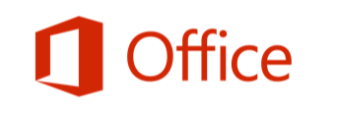



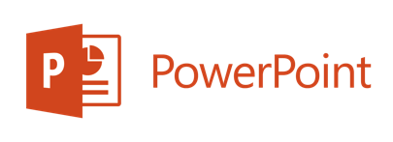

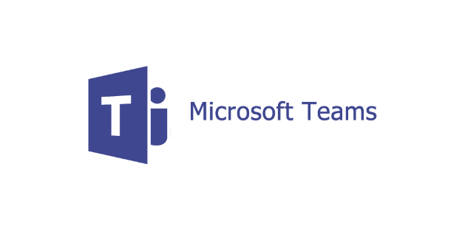

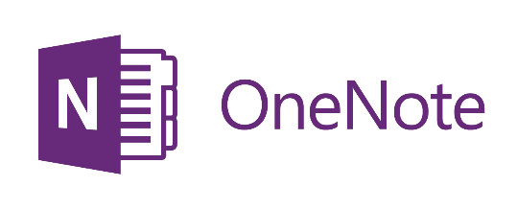


All you need for best-in-class productivity.
Create and edit documents in real time with colleagues
Communicate with customers, collaborate with colleagues, gain access to data and storage
Sync files across all your devices
Notes:
Office 365 is your productivity tool that’s powered by the cloud. Installed on local devices so you still have control. Your private information and proprietary assets are not in the public ether for everyone to access. They are secure and in your control. You can control who sees those files.
Office 365 includes all the content creation applications you and your customers know and use:
Word, Excel, PowerPoint, also available via the web via Office Online.
And Office 365 provides a set of services that enables communications, collaboration, data access and storage across your devices:
Outlook
OneDrive for Business
Skype for Business
Yammer
Online or offline, at their desks or on the go, from multiple devices – you can help ensure that your staff and customers gets to what they need – when and where they need it.
Don’t forget that with Office 365, Microsoft provides updates to features and services on an ongoing basis.

Slide 6
Modern Workplace
Practice/Solution | Practice building Block | Workloads
Collaboration | Modern Collaboration and Effective Teamwork | Office 365 Pro Plus Teams Exchange Online SharePoint Online OneDrive for Business Yammer | Power Apps Flow Power BI Pro MyAnalytics Workplace Analytics | MyAnalytics Workplace Analytics Planner Sway Delve Microsoft Graph Stream Voicemail | Planner Sway Delve Microsoft Graph Stream Voicemail
 | Employee Engagement and Empowerment
 | First Line Workers
Modern Desktop | Modern Desktop Deployment | Windows 10 Deployment – New Device Windows 10 Deployment – Existing Device O365 Pro Plus
 | Modern Desktop Managed Services | Windows 10 Post-Deployment Managed Services
Security and Compliance | Enterprise-level Identity protection | Identity Driven Security Identity and Access Management Security and Compliance
 | Control and protect information | Managed Mobile Productivity Information Protection Security and Compliance
 | Regulatory compliance | Information Protection Security and Compliance
 | Proactive attack detection and prevention | Desktop Virtualization Security and Compliance Windows Defender ATP
Cloud Voice | Modern Meetings with PSTN dial-in | Cloud PBX Hybrid Cloud PBX with CCE SBC and Gateways PSTN Calling and Conferencing Contact Center (ISV) |  | Cloud Video Interoperability (Polycom) Windows and mobile clients Skype Room Systems Surface Hub
 | Cloud PBX enablement

Slide 7
Collaboration
Practice building block | Practice building block details
Modern Collaboration and Effective Teamwork | Develop collaboration strategies for customers including application and content migration plans Leverage FastTrack IP and Tools to migrate mail and files to the cloud Provide adoption and change-management services to enable customers to realize the value of modern collaboration with MS Teams and SharePoint in conjunction with migration and rollout activities Deliver vertical solutions in regulated industries to unlock new opportunities e.g. Healthcare - Care Coordination, FSI – Product Development, Government – Case Management; etc.
Employee Engagement and Empowerment | Create and deliver SharePoint Intelligent Intranets/Intranet-as-a-service and portal-related solutions Drive Yammer adoption to inform and engage employees Enterprise Content Management Automate tasks and processes with Connectors, PowerApps and Flow Develop custom apps using the SharePoint Framework
First Line Workers | Increase engagement with first line workers by providing them with modern communication and collaboration tools Enable shift scheduling and integrate with workforce management applications Provide training, support and device management services Integrate with LoB apps to automate and optimize operations processes e.g. Retail – Store Task Management, Manufacturing – Troubleshooting, etc.

Slide 8

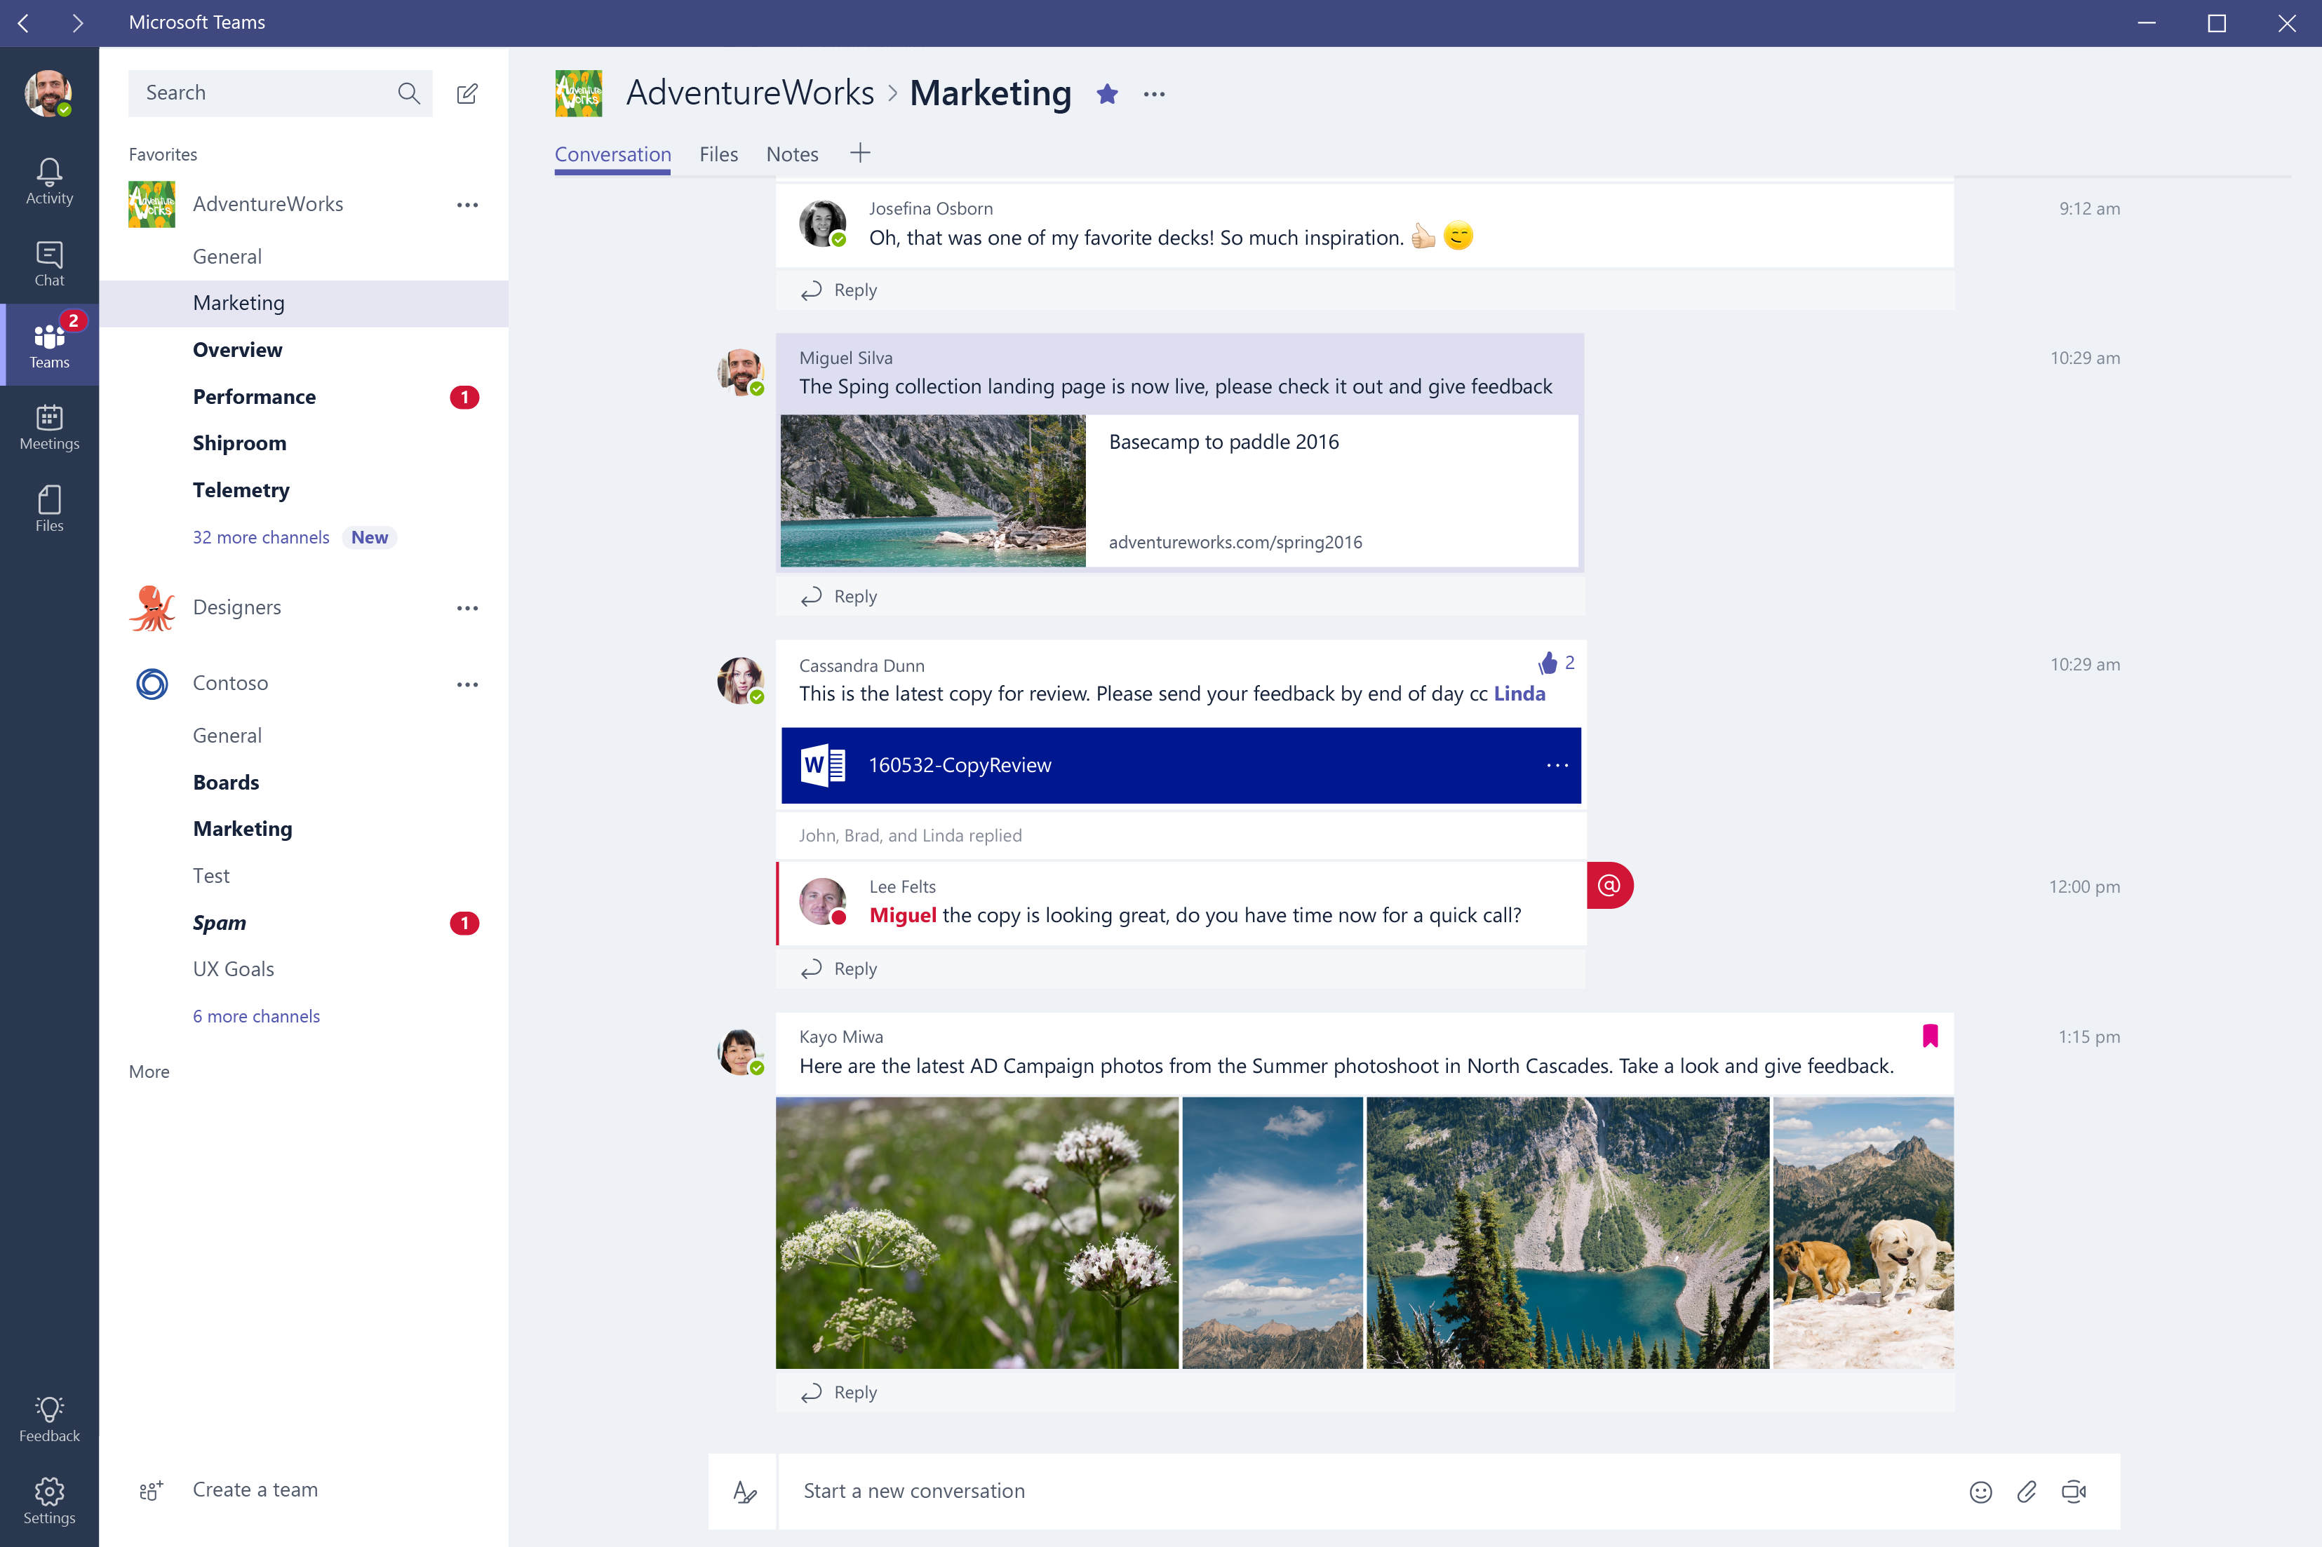
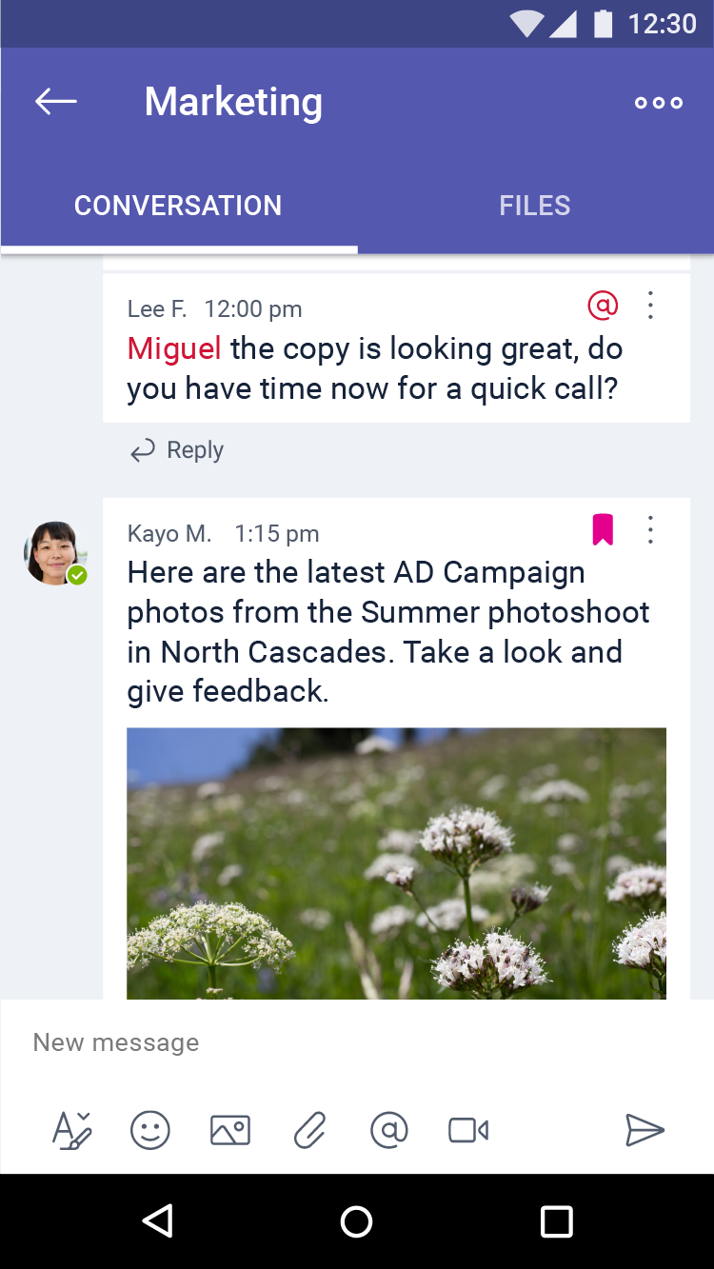

Microsoft Teams, a chat-centered workspace
Chat for today’s teams to keep everyone in the know
A hub for teamwork integrated with Office 365
Security teams trust with enterprise-level protection
Customizable for each team with content and capabilities
“We need secure and trusted collaboration solutions that bring teams and their work together. Based on our early use of Microsoft Teams in Office 365, we believe it is the digital cockpit we’ve been waiting for.”
Notes:
First and foremost, it provides a modern experience for conversations for today’s teams. Teams supports not only persistent but threaded chats to keep everyone engaged. Team conversations are, by default, visible to the entire team, but there is of course the ability for private discussions. Skype is deeply integrated, so teams can participate in voice and video conferences fluidly. And the experience itself is fun, and this matters to teams… With emojis, stickers, GIFs, and custom memes, Teams makes it easy to for people to add personality and uniqueness to their conversations.
Second, Microsoft Teams brings together the full breadth and depth of Office 365, providing a true hub for teamwork. Word, Excel, PowerPoint, SharePoint, OneNote, Planner, Delve, and PowerBI are built into Teams so people have all the information and tools they need at their fingertips. Backed by the Microsoft Graph, intelligent services are surfaced throughout the experience to help with information relevancy, discovery, and sharing. Microsoft Teams is also built on Office 365 Groups. Groups is our cross application membership service that makes it easy for people to move naturally from one collaboration tool to another, preserve their sense of context, and share with others. And finally, Microsoft Teams is built for each of us, meeting accessibility standards so every team member can participate.
And all teams are unique, so we’ve also invested deeply in ways for people to customize their team environment through rich extensibility and open APIs. For example, team members can create their own channels to organize conversations. They can integrate their favorite cloud services with a feature called Tabs, that will provide quick access to frequently used content and information. Teams shares the same Connector model as Exchange, providing notifications and updates from 3rd party services like Twitter or GitHub, directly within the experience. And lastly, we are including full support for the Microsoft Bot Framework to bring intelligent 1st and 3rd party services into your team environment.
Finally, because it’s built on Office 365, Teams also has the advanced security and compliance capabilities that our Office 365 commercial customers expect. Data is encrypted at all times. Like all our commercial services, there is no standing access to customer data, and we have a transparent operational model, with a financially-backed SLA. Microsoft Teams will of course support key compliance standards including EU Model Clauses, ISO27001, HIPPA, and more. And, as customers would expect, Teams is served out of our hyper-scale global network of datacenters, automatically provisioned within Office 365, and managed centrally just as another Office 365 service.

Slide 9
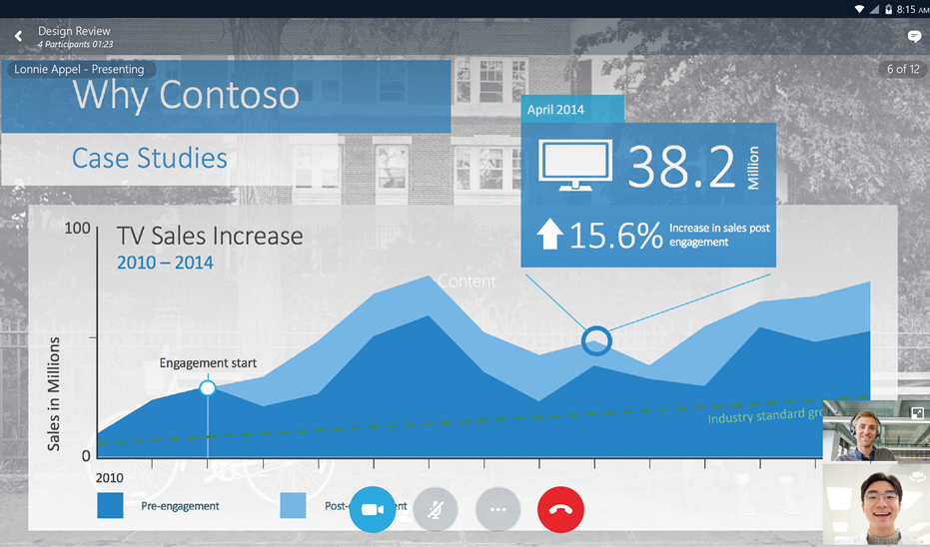

Complete cloud communications with Skype
Text, meet, and call, across devices, with VoIP & PSTN
Reduce travel using audio, HD video & web conferencing
Unify your global phone systems with Cloud PBX
Reach out to your employees with Skype Meeting Broadcast
Engage your customers, using Skype in your web pages & apps
“ Working together to make product and business decisions faster is a key to success for the Kraft Heinz Company. We see PSTN Conferencing and Cloud PBX through Skype for Business as a great opportunity to help employees connect quickly wherever they are. ”
Notes:
New PSTN calling and conferencing capabilities in Office 365 E5
Complete platform - VOIP, PSTN, conferencing, sophisticated cloud PBX
Even things like Skype Meeting Broadcast to reach out to employees

Slide 10
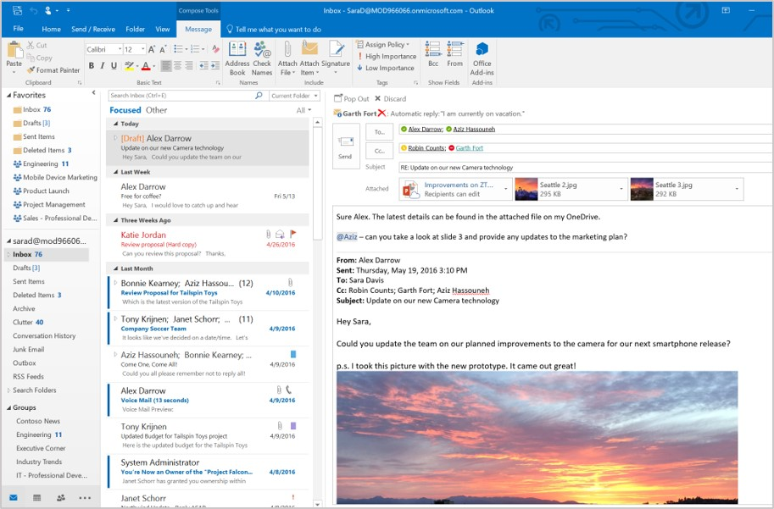

Smarter email and calendaring with Outlook
Stay on top of what matters with a focused inbox
Share OneDrive files easily as cloud attachments
Call attention to critical actions & input with @mentions
Go beyond distribution lists with a group inbox & calendar
Easy onboarding for new members with full group history
“ Office 365 Groups are easy for anyone to create, and they’re particularly effective when used in conjunction with Microsoft Outlook, because everything related to a project shows up right within Outlook, which is where I spend most of my day. ”
Notes:
Objective: Double click on collaboration in each Office 365 application
Outlook is our hero for email and calendaring
Not the same old email
Focused inbox
Cloud attachments, @ mentions
Group inbox, go beyond DLs - also gives new members a full history
First class mobile experience

Slide 11
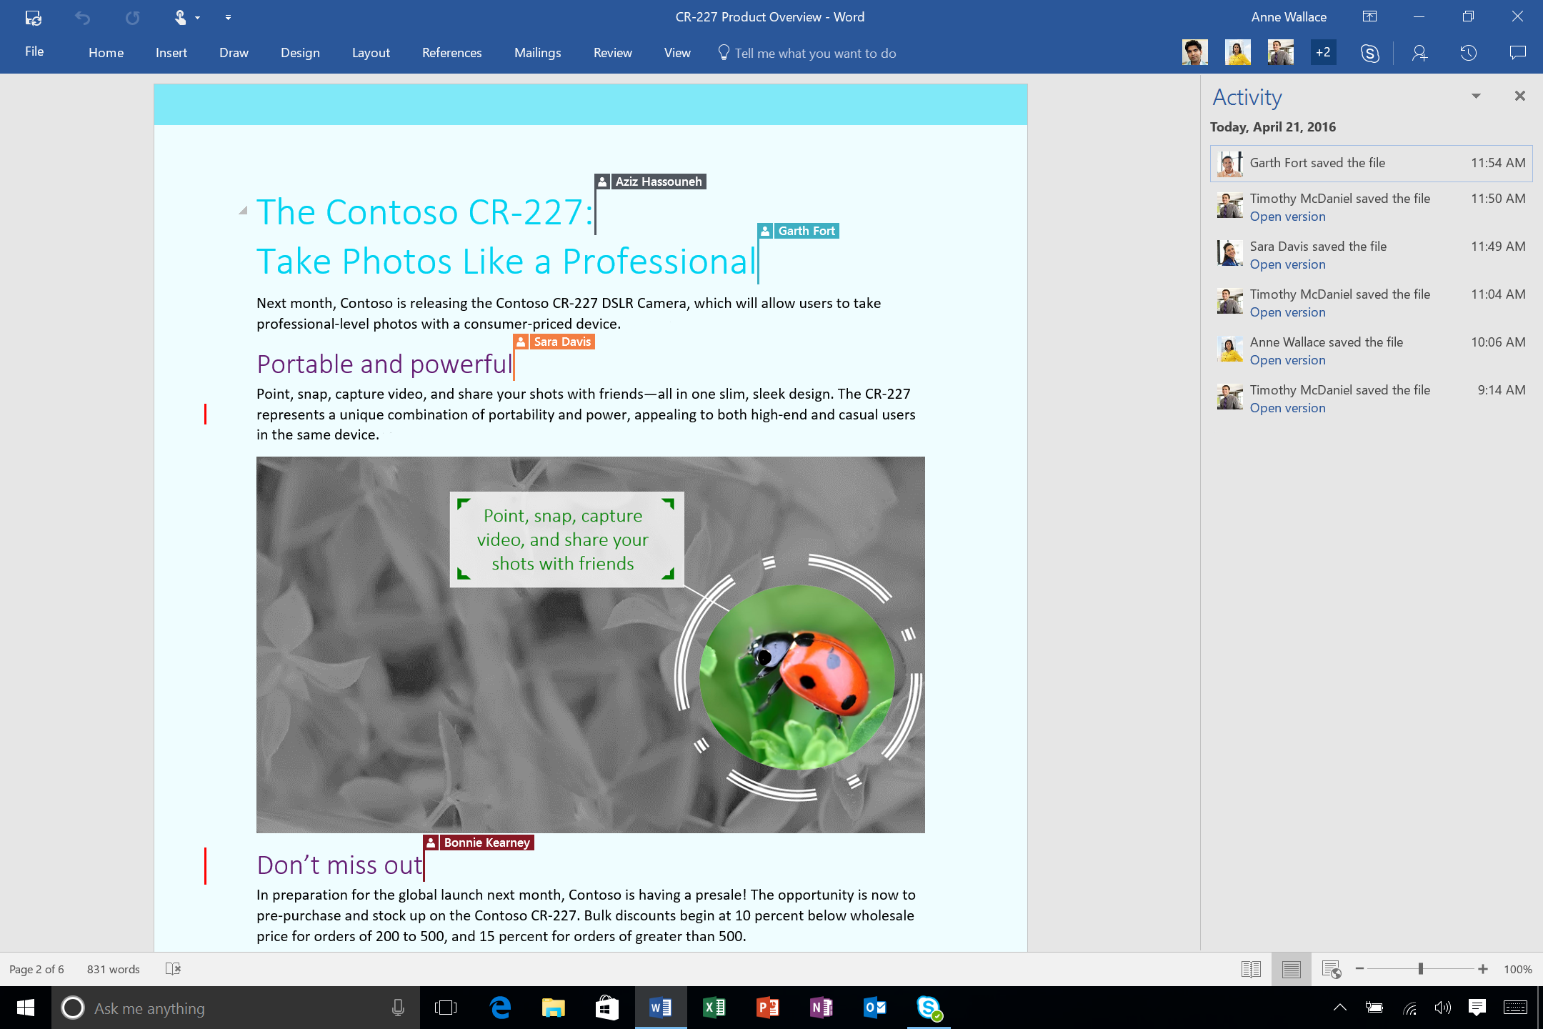
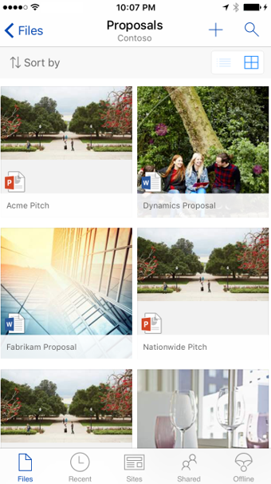

Create, share, find content with Office & OneDrive
Co-author together in real time in Office applications
Store, sync & share files inside or outside your org
Find, follow & discover content from anywhere on any device
Manage document revisions with integrated feed & version history
Receive comments & changes while on the go with notifications
“ Whether it is co-editing documents on the fly with team members in different countries or reviewing PowerPoint decks on a tablet in a taxi before a meeting, using Office 365 helps dispersed teams provide responsive service to our customers. ”
Notes:
Next, create, sharing and find content with Office client
Co-author together, lot of people don't know that we have co-auth across mobile, client and web

Slide 12
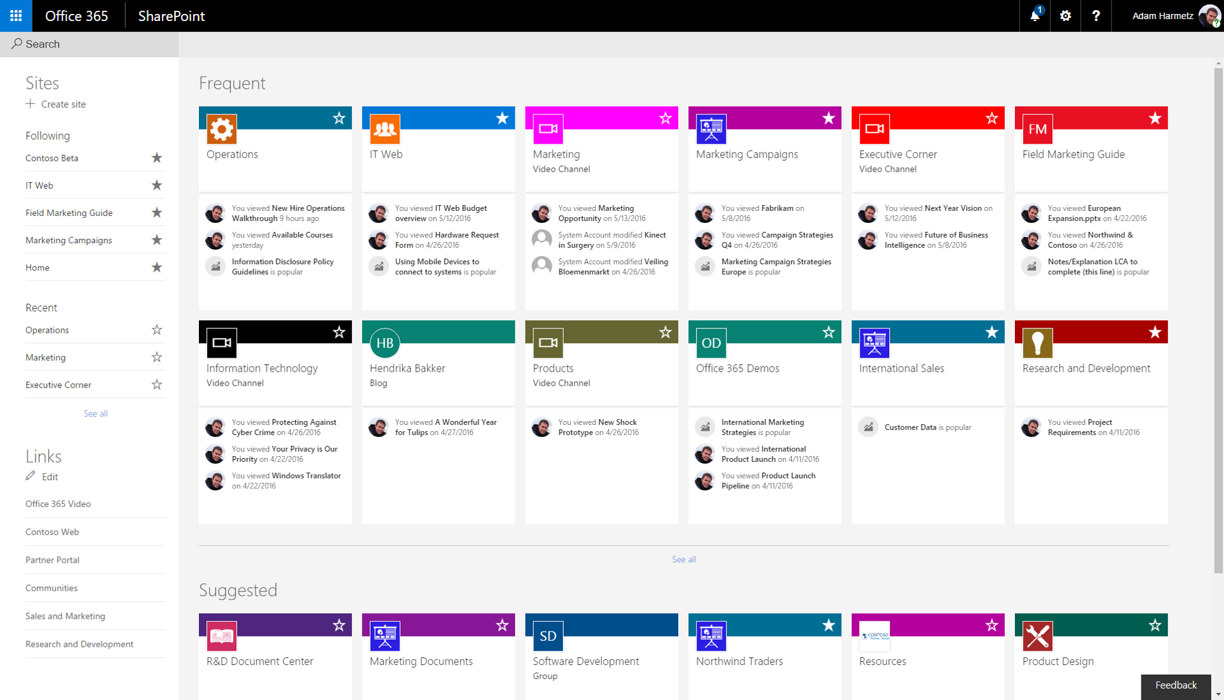
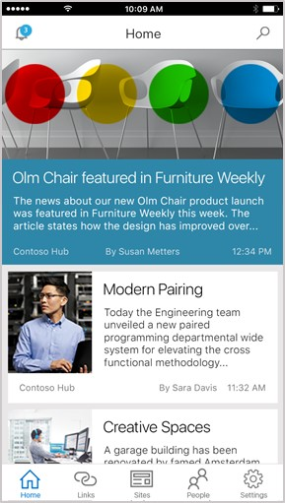
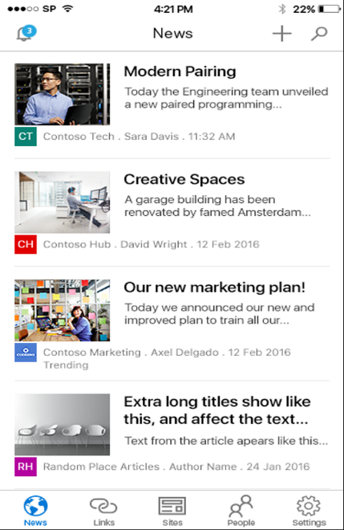

Modern content, sharing & discovery with SharePoint
Access sites & content anywhere with your Intranet in your pocket
Manage & collaborate on content with your team
Navigate your intranet with intelligent recommendations
Create beautiful team sites & publishing sites quickly
Automate business processes with Microsoft Flow & PowerApps
“ SharePoint Online encourages employees to be more efficient in their daily work. They can access the documents they are working on anytime and anywhere from smartphones, tablets, and when they are out of the office traveling. This is our vision for the future.”
Notes:
Continuing to invest and innovate in SharePoint
Intranet in your pocket
New UI design

Slide 13
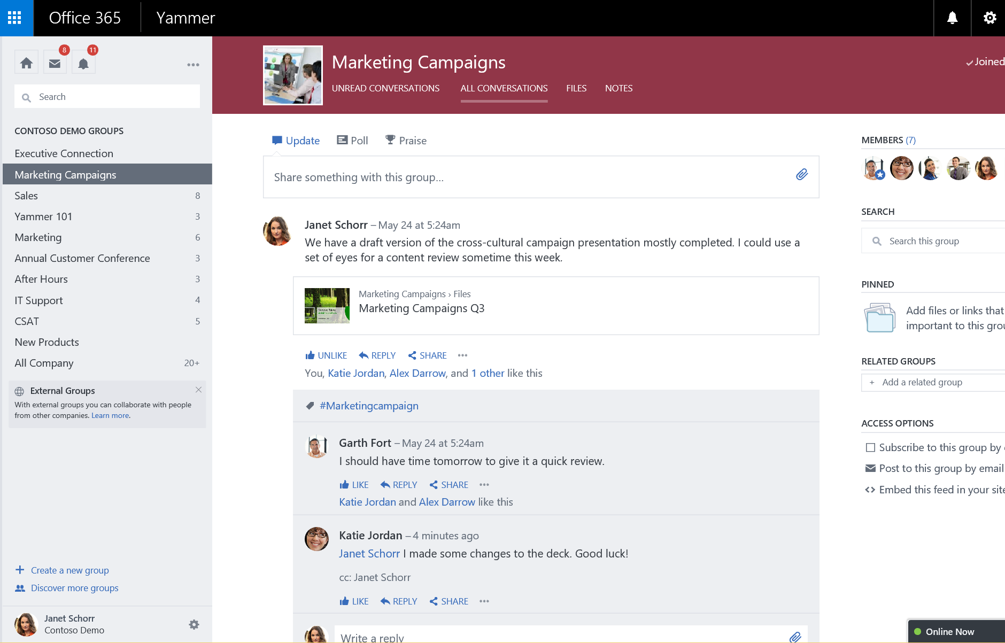
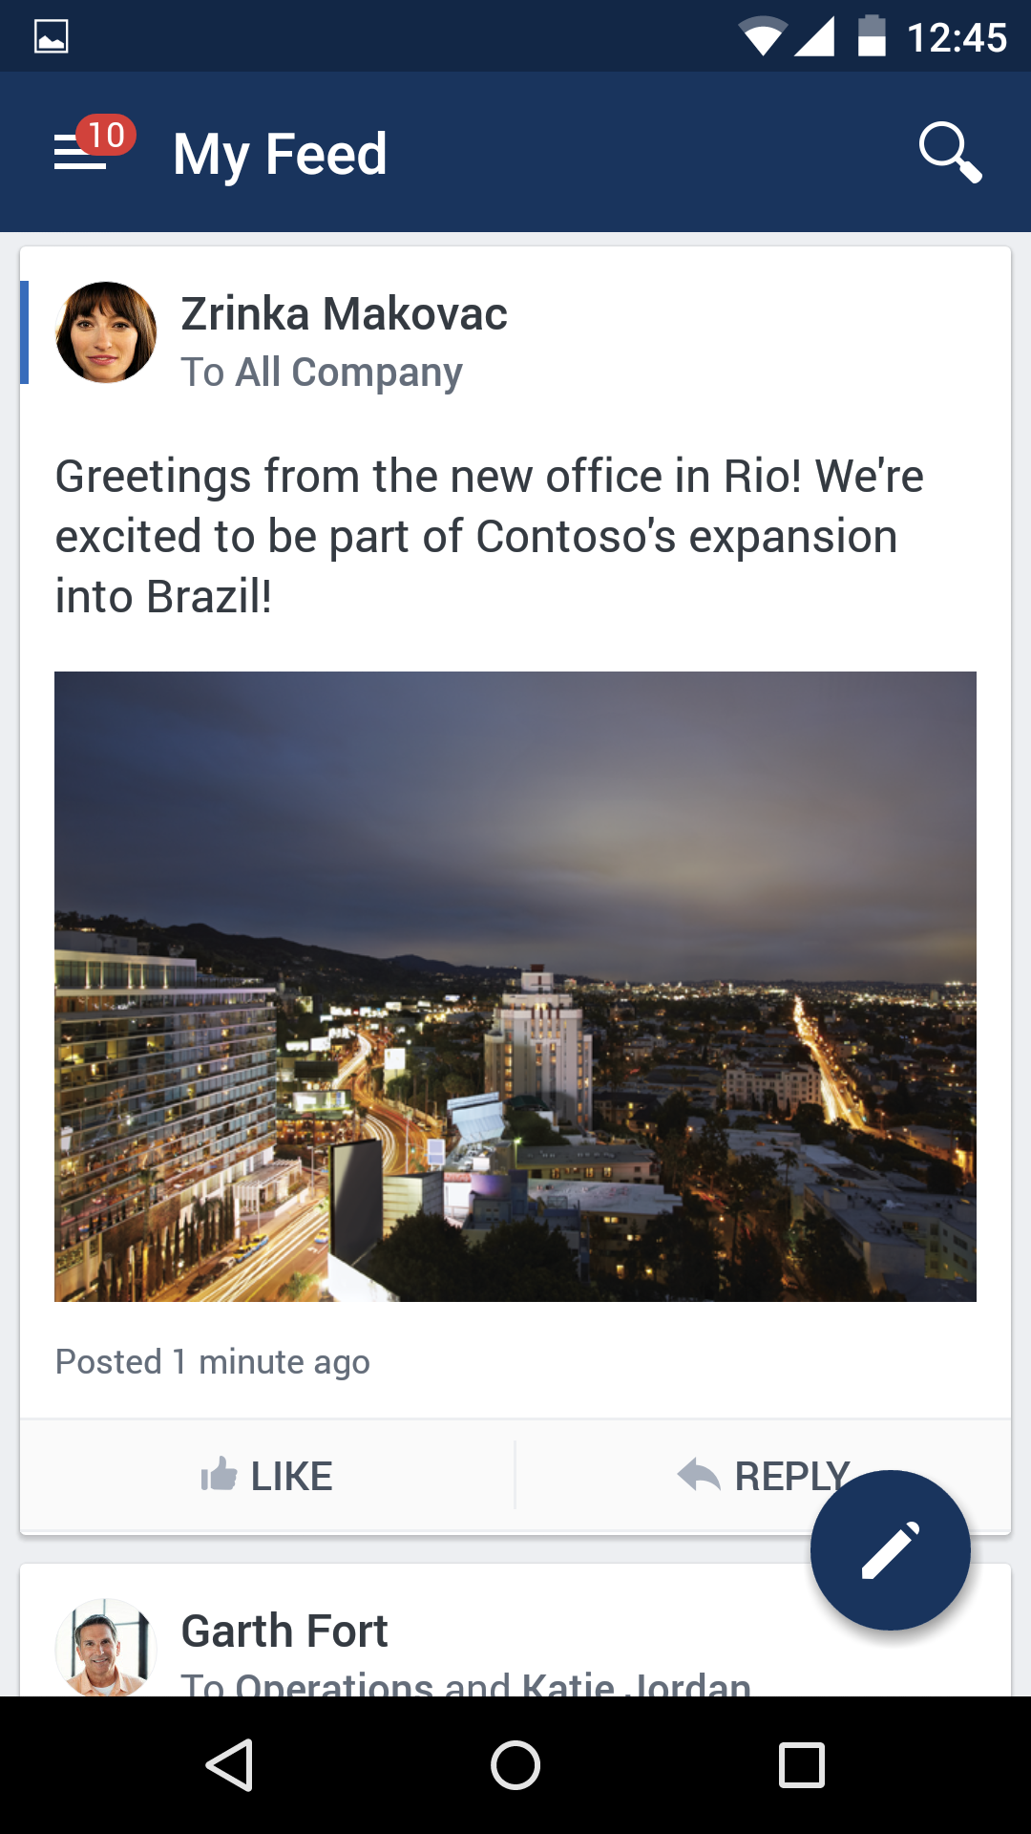

Connect with Yammer, the social network for work
Foster open team discussions with the group feed
Tap into collective knowledge with search & discovery
Crowdsource ideas & share best practices across the org
Get the pulse of your company using polls, praise & follows
Drive employee engagement with actionable updates & alerts
“ In my experience, the best ideas come from people who wouldn’t normally work together. Yammer makes that happen. ”
Notes:
One of my favorites, Yammer, social network built for work
Foster open discussions across your company
Unicef quote - best ideas come from ppl who don't normally work together

Slide 14
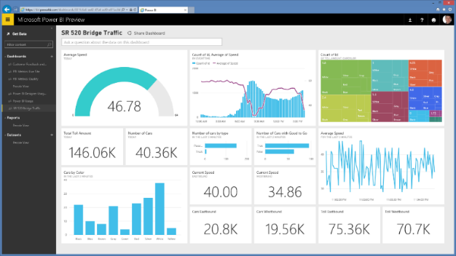
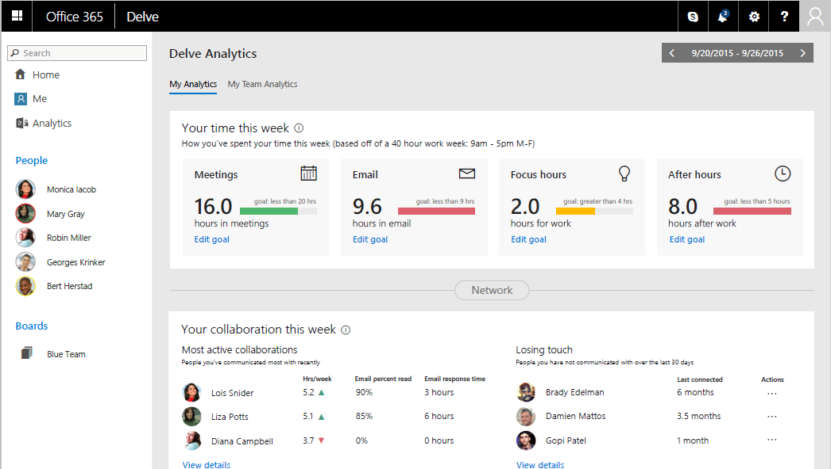
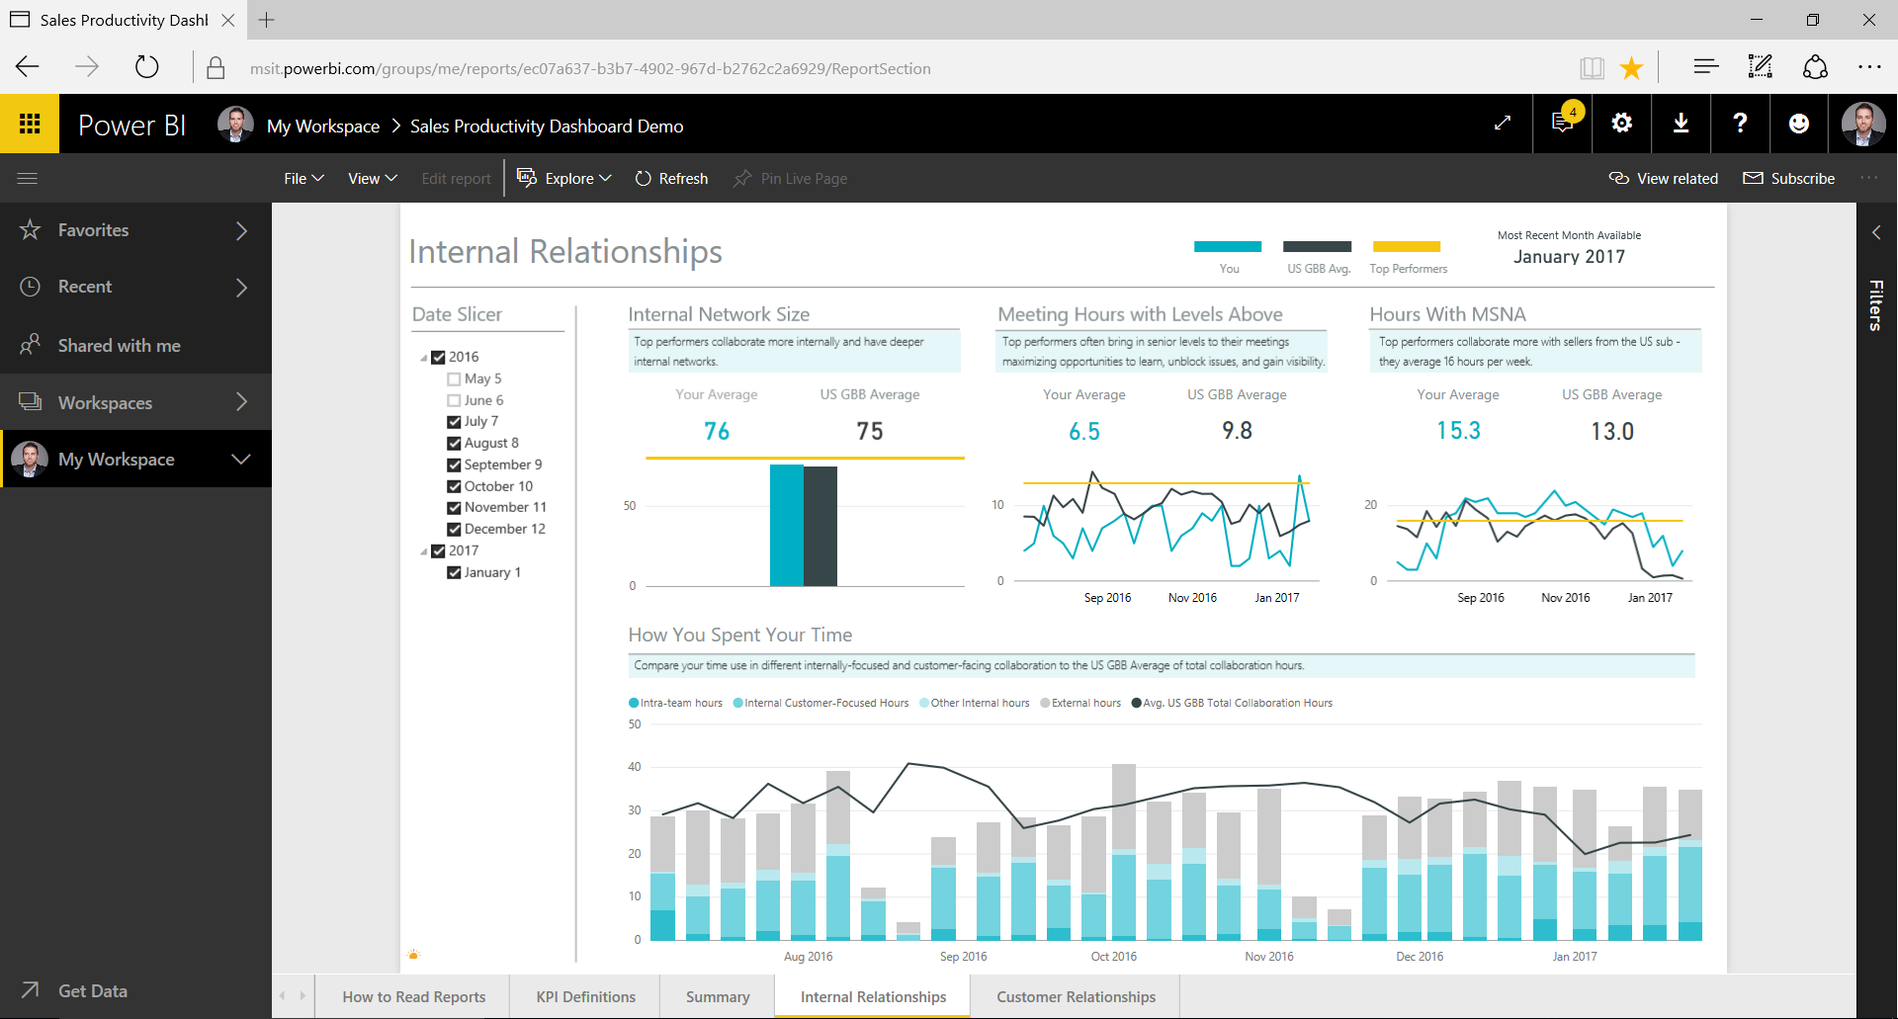
Analytics
Power BI Pro
Gain fast, easy access to the data you need with a simple intuitive experience
Access a live, 360º view of your business through a single dashboard
Discover new insights by exploring your data with rich visualizations
Power BI Pro
MyAnalytics
Leverage personal analytics to improve individual effectiveness
Use the Outlook add-in to understand email reach and impact
Identify top collaborators and understand collaboration trends
Workplace Analytics (Lead Status Add On)
Add-on to E1/E3 ($6/u/m) & add-on to E5 ($2/u/m), minimum 5K seats
Incremental pricing for Advanced Analytics consulting services
New Office 365 capabilities to drive org-wide change: actionable behavioral metrics, custom queries, data remains in place, complements existing MyAnalytics capabilities
Coming soon: accelerate change initiatives with connective tissue to cascade custom goals & targeted benchmarks from Workplace Analytics to MyAnalytics
MyAnalytics
Workplace Analytics
Notes:
Take a closer look at Analytics capabilities in E5
Power BI transforms your company’s data into rich visuals and analytics, so you can focus on what matters to you. Stay in the know, spot trends as they happen, and push your business further. With Power BI, you can:
Get an end-to-end view off what is happening
Manage multiple data sources
Make the right data available to the right users at the right time
In addition, with out-of-the-box Power BI content packs for popular services such as Salesforce, QuickBooks Online, Marketo, you can create data visualizations in just minutes. You can also publish data from Excel 2016 to Power BI, making it even easier to share data and insights.
MyAnalytics (formerly Delve Analytics) helps you understand time management, business efficiency, and organizational collaboration patterns by using big data and behavioral analytics to reveal how activities drive business outcomes. Everyone from individual employees to team leaders and managers can use MyAnalytics to monitor patterns and find ways to get time back and spend it more effectively.
MyAnalytics Personal Dashboard helps you discover trends for the most important aspects of your day like meetings, email, focus time, and after hours. Use this information to assess how to most effectively rebalance your schedule.
Outlook add-in offers quick feedback about when emails are opened by your colleagues and how many recipients actually read the email you send. Use this information to understand the best time of day to send email and alter content to ensure high read rates. You can also use the email-read analytics to explore read rates, activity trends, and other characteristics of emails that were sent to you.
Email Digest delivers weekly summaries of activity and collaboration characteristics that provide you with simple feedback about time allocation and networking.

Slide 15
Security and Compliance
Practice building Block | Practice building block details
Enterprise-level Identity protection | Identity Driven Security: Protect organizational data, manage policies and prevent data leakage with mobile apps, control data on-premises and in the cloud. Enable business without borders, manage access at scale using cloud-powered protection Identity and Access Management: 1,000's of apps: 1 identity, enable business without borders, manage access at scale, cloud-powered protection
Control and protect information | Information Protection: Classify, label and protect sensitive data, share sensitive data internally and externally and data loss prevention Increase compliance level by adding procedures in place for explicit data access authorization Analyze unstructured data, perform more efficient document review, and make decisions to reduce the data and time needed for eDiscovery
Regulatory compliance | General Data Protection Regulation (GDPR): Discover, Manage, Protect, Report. Secure access and protect data on mobile devices, apps, and PC’s. Classify, label and protect sensitive data and prevent data loss Compliance offerings: Comply with national, regional, and industry-specific requirements governing the collection and use of individuals’ data. Analyze unstructured data, perform efficient document review
Proactive attack detection and prevention | Cyber Security Risk Assessment: perform a security assessment analysis to understand security risks Managed Security Services Offering: Security Monitoring, Incident Recovery, Patch Management, and Remediation for advanced targeted attacks, and policy recommendation and improvement Migration and Deployment Services: Migrate customers from competitive solutions and deploy Microsoft Security solutions Managed Mobile Productivity: Secure access to Microsoft cloud and protect data on unmanaged devices, enable a BYOD program in customer organization, enable a limited-use shared device solution for task workers/education Virtualization: Build and Deploy, Secure Virtual Desktops. Secure access to on-premises resources like network, emails, files, and apps and protect data

Slide 16
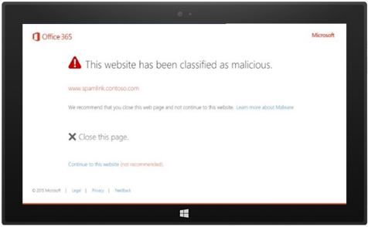
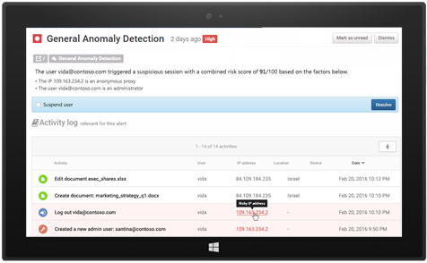
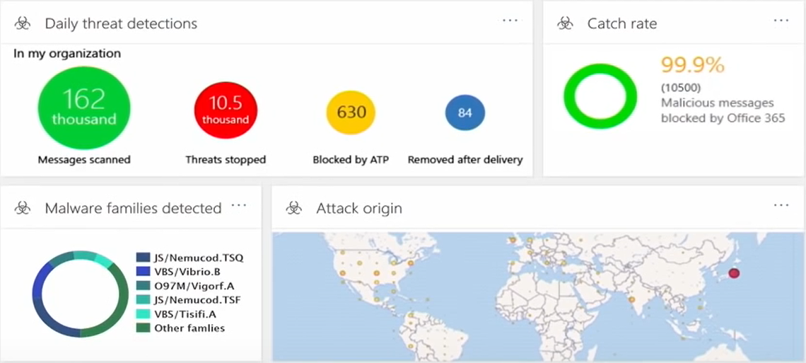
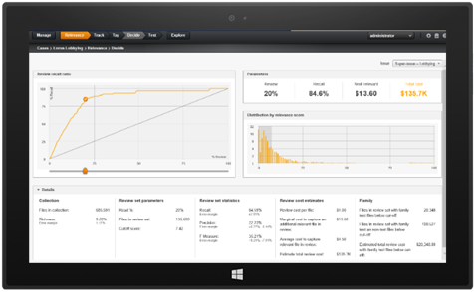
Security
Advanced Threat Protection
Help protect against unknown malware and viruses
Provide real-time, time-of-click protection against malicious URLs
Deliver rich reporting and URL trace capabilities with Click Tracing
Advanced Threat Protection
Advanced Security Management
Identify high-risk and abnormal usage, security incidents, and threats
Gain enhanced visibility and context into Office 365 usage and shadow IT
Reduce the possibility of attacks with granular controls that monitor access
Threat Intelligence
Actionable insights to global attack threats
Billions of data points from Office, Windows & Azure customers
AI to enable adaptive security policies and best practices
Advanced Security Management
Advanced Compliance
Focus on what is unique and relevant by training the system to identify emails and documents through predictive coding
Reduce document volume with Near Duplicates and Email Threading
Includes Advanced eDiscovery, Advanced Data Governance and Customer Lockbox
Threat Intelligence
Advanced Compliance
Notes:
Take a closer look at E5 security and compliance capabilities that continue Microsoft’s deep investments in security
Advanced Threat Protection (ATP)
With Office 365, you gain advanced protection against unknown and sophisticated threats in end-user email, attachments, and URLs. ATP includes three key capabilities:
Safe Attachments protect against unknown malware and viruses by opening documents attached to emails in cordoned-off virtual environments (VM’s) to detect malicious behavior.
Safe Links provide real time, time-of-click protection against malicious URLs by wrapping external links in special URLs that check the destination URL for threats before opening them.
Click Trace provides rich reporting and URL trace capabilities by keeping a record of every user who has clicked on a Safe Link-wrapped URL for additional protection.
Advanced Security Management
With the Advanced Security Management capabilities in Office 365, your security administrators have access to the granular controls and policies they need to monitor access and reduce the possibility of attacks:
Advanced Security Alerts. Admins can use General Anomaly Detection alerts and granular activity policies to react quickly to suspicious activity.
App Permissions enable IT to approve or revoke access for third-party apps or services that users authorize to connect to Office 365.
Cloud App Discovery enables IT to monitor what cloud services users connect to, so they can gain insights, identify anomalies, and manage risky behavior.
Customer Lockbox
Providing security, transparency, and compliance in Office 365 is our top priority. Customer Lockbox for Office 365 can help you meet compliance obligations, such as HIPPA and FedRAMP, by demonstrating that they have procedures in place for explicit data access authorization. In the rare instance when a Microsoft service engineer needs access to your data, you grant that access only to data required to resolve the issue and for a limited amount of time. Additionally, those actions taken by the support engineer are logged for auditing purposes and are accessible via the management Activity API and the Security and Compliance Center.
Advanced Compliance
Finally, Office 365 Advanced Compliance simplifies the eDiscovery process across your email and document repositories. It leverages machine learning to help you explore large, unstructured sets of data and quickly find what is relevant.
Thread Analysis reconstructs email threads from unstructured data.
Duplicate Detection reduces document volume so you can focus on what is unique.
Predictive coding trains the system to identify relevant email and documents.
Themes and Search help you quickly map unstructured data by using clustering technology to identify data relationships and simplify email reviews.
It’s easy to see why this is the most secure Office ever.

Slide 17
Cloud Voice
Practice building block | Practice building block details
Modern Meetings with PSTN dial-in | Replace existing traditional audio conferencing providers or add PSTN capabilities to Skype for Business meetings Planning activities (envision the solution, assess overall readiness, determine network readiness, design the solution) Deliver activities (deploy, migrate and roll out, enable accounts at scale, develop habitual use) Operate activities (support the solution, proactively monitor the solution, Manage daily operations, reporting service Usage)
Cloud PBX enablement | Replace existing PBX, migrate to a Cloud PBX solution, integrate existing traditional PBX with Cloud PBX, enable new branches with Cloud PBX Planning activities (envision the solution, assess overall readiness, determine network readiness, design the solution) Deliver activities (deploy, migrate and roll out, enable accounts at scale, develop habitual use) Operate activities (support the solution, proactively monitor the solution, Manage daily operations, reporting service Usage)

Slide 18
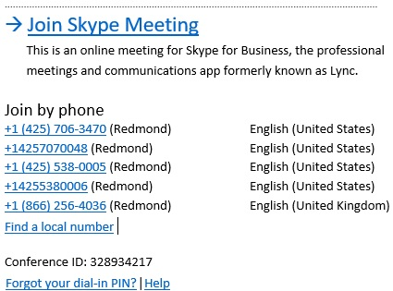
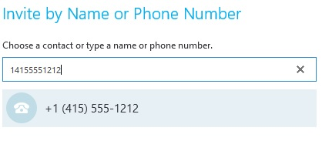
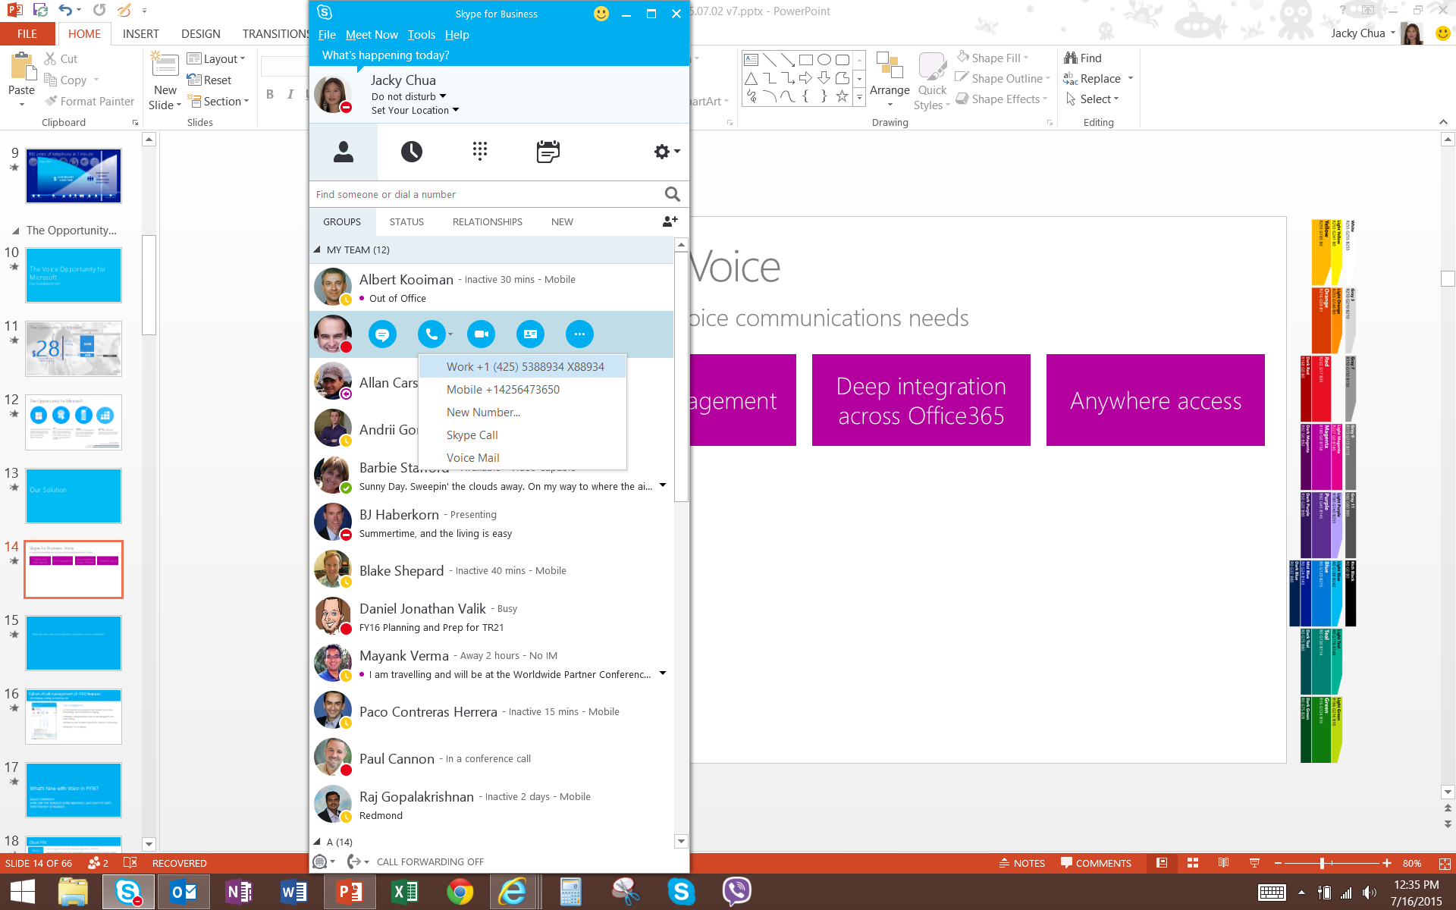
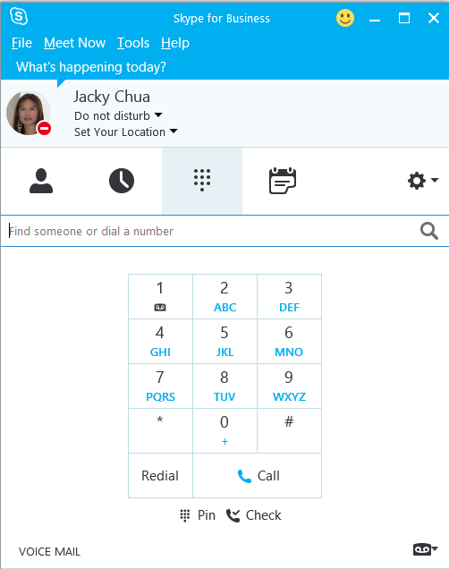
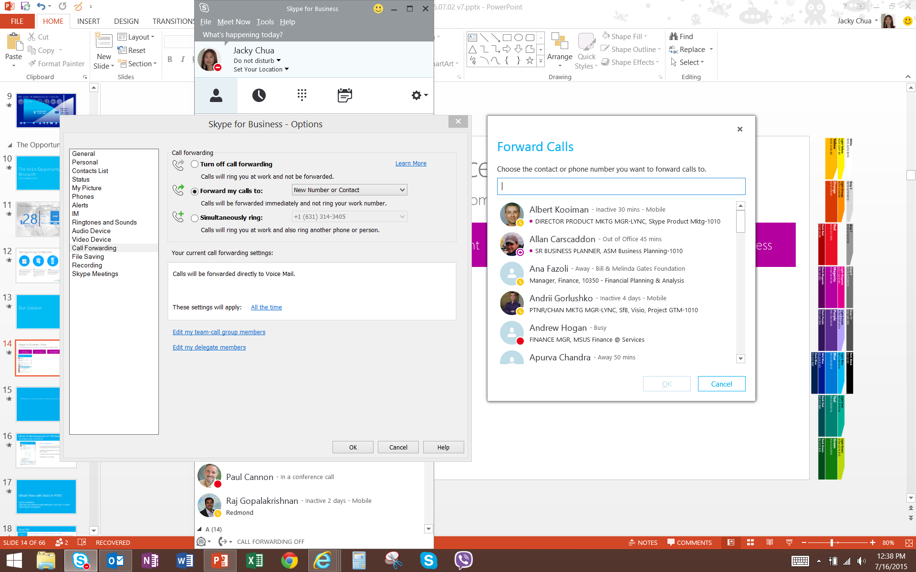
Voice
PSTN Conferencing
Use a tolled dial-in number to join meetings from any device
Dial out to bring participants into the meeting
X
Cloud PBX
Centrally manage users for communications, email, and content from Office 365
Eliminate separate PBX systems and transition to the cloud
PSTN Conferencing
PSTN Calling¹
Subscribe to calling plans from Office 365
Use existing phone numbers or get new ones
Cloud PBX
PSTN Calling*
¹PSTN Calling is an add-on to Office 365
Notes:
Skype for Business and Office 365 offer you all the capabilities you need for modern voice and meetings. Audio, video, and web meetings are combined in one connected user experience and platform, with high definition video and a broad range of devices from Microsoft and partners. This helps your business consolidate conferencing solutions and simplify operations while reducing complexity for users, reducing support costs for IT, and enabling employees to work from virtually anywhere.
With PSTN Conferencing, meeting attendees without Internet or audio access on their PCs can dial in to Skype meetings from virtually any device. Meeting organizers can also dial out to attendees and bring them into the meeting. PSTN Conferencing also offers unlimited conferencing as a part of the service, so no charges are incurred for callers using a tolled number to dial-in.
Cloud PBX (when combined with PSTN Calling) is your phone system in the cloud, modern, and tightly integrated with Office 365. Users get the voice capabilities they need—make, receive, and manage calls from anywhere, using any device. (PSTN Calling is required for a true enterprise voice solution.) Cloud PBX also provides great controls for IT to increase agility and consolidate management compared to traditional phone hardware.
PSTN Calling is an add-on to Cloud PBX that provides domestic and international calling services for businesses directly from Office 365. Instead of contracting with a traditional telephony carrier and using an on-premises IP-PBX, you can purchase the Cloud PBX from Microsoft and add on PSTN Calling for a complete enterprise telephony experience for end-users.
--------------------------------------------------------------------------------------------------------------------------------------------------------------------------------------
Differences between E3 and E5
MEETINGS
With E3, you have audio, video, and web conferencing on the Internet
With E3, scales from 2 to 10,000 people
With E3, easy join via smartphone, tablet, PC, Mac, and browser
With E5, PSTN Conferencing adds dial-in numbers around the world for joining by phone when more convenient or when Internet is unavailable.
VOICE
With E3, Person-to-person calling on the Internet
With E3, Reach Skype users in your company and worldwide
With E3, Dial-by-name from Office on smartphone, tablet, PC, Mac
With E5, Cloud PBX adds sophisticated calling features including voice mail, call transfer, admin support, plus option to call traditional phone numbers
Save $5 per user* by enabling Cloud PBX, retiring Cisco or other traditional PBX system (Based on Cisco Call Manager price of $13 per month vs. Cloud PBX at $8)

Slide 19
Office 365 Enterprise Suites
 | E1 | E3 | E5
Features Office 365 Services | $8 | $20 | $35
Business Class Email and Calendars Exchange Online | 50 GB | Unlimited | Unlimited
Social, Video, Sites, Work Management Yammer, Office 365 Video, Stream, SharePoint Online, Planner | ● | ● | ●
IM, Online Meetings, Meeting Broadcast, Collaboration, StaffHub Skype for Business, Microsoft Teams | ● | ● | ●
File Storage, Sharing, Information Discovery OneDrive for Business | ● | ● | ●
Office Online | ● | ● | ●
Office Client Apps Office 365 ProPlus |  | ● | ●
Archiving, Rights Management, Data Loss Prevention, Encryption |  | ● | ●
Advanced Security Management, Advanced Compliance¹, Secure Attachments and URLs, Threat Intelligence |  |  | ●
Analytics Power BI Pro, MyAnalytics |  |  | ●
Cloud PBX Skype for Business |  |  | ●
PSTN Conferencing² Skype for Business |  |  | ●
Enterprise Plan Add-ons
PSTN Domestic and International Calling³ Skype for Business | +$32 | +$32 | +$12/$24
Workplace Analytics⁴ | +$6 | +$6 | +$2
CRM Online Professional Dynamics |  | +$50 | +$50
¹At launch on April 1, 2017, limited ADG capabilities will be available in GCC; additional features will roll out at later dates. For details view the Government Licensing FAQ.
²Toll-free and International Dial-out conferencing capabilities will incur additional per minute consumption charges when available. Customers can disable this feature to avoid additional billing. Limited geo availability.
³Domestic only calling plans are $12. Tax is included in price in USA, Puerto Rico & Canada. Add-On price to E1 & E3 includes Cloud PBX.
⁴5,000 Seat Minimum

Slide 20
Modern Workplace
Developer Experience Overview

Slide 21



Modern Workplace Platform
Bringing It All Together
Extend with Add-Ins
Extend the functionality of Microsoft’s applications
Power With Graph
Integrate Microsoft’s services into Developer’s applications
Interact with Bots & Cards
Converse with users beyond application boundaries

Slide 22
Modern Web Add-Ins
OneNote
SharePoint
PowerPoint
Visio
Word
Teams
Outlook
Excel
Extend existing Microsoft 1st Party applications
Inherently cross-platform
Centrally deployable organizationally or publicly
Built entirely on web technologies
If you’re a Web developer, you’re an Office developer

Slide 23
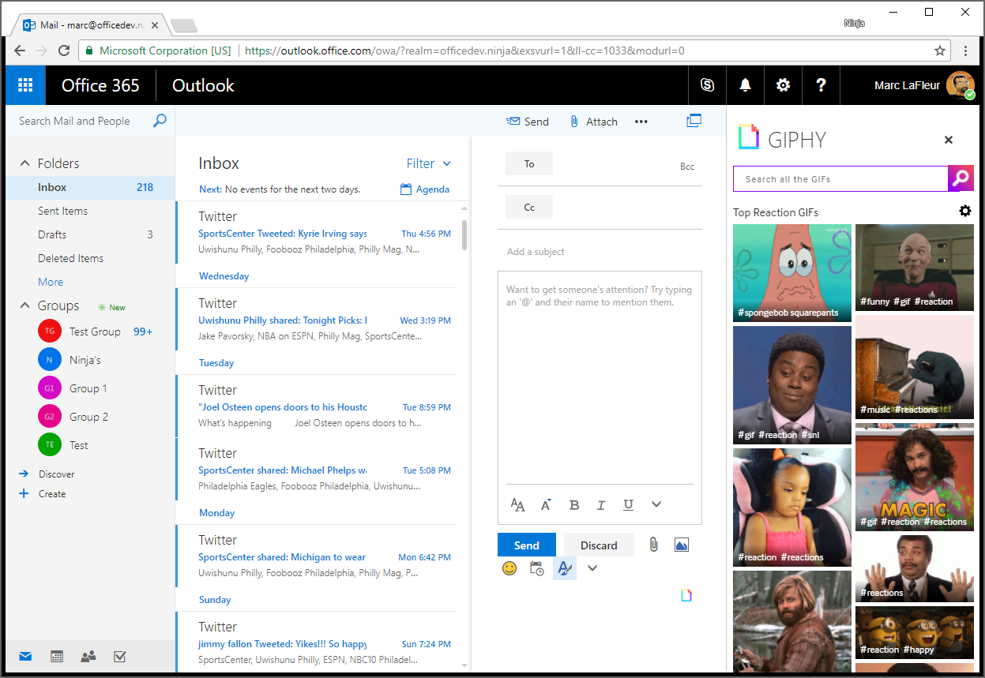
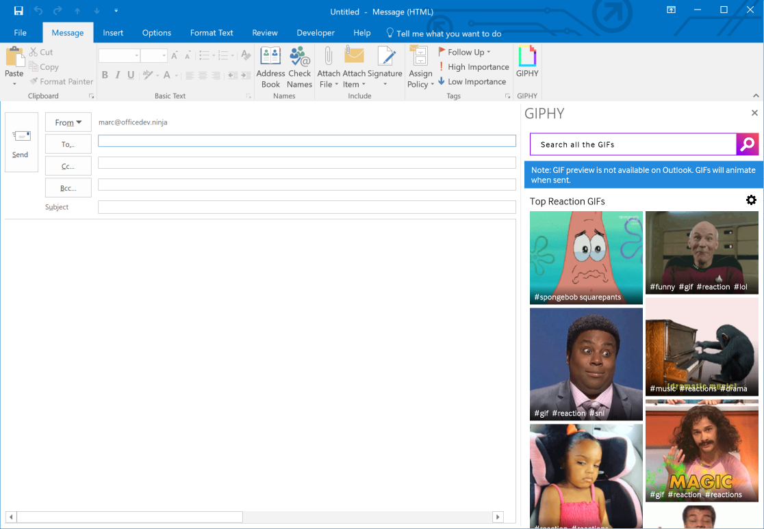
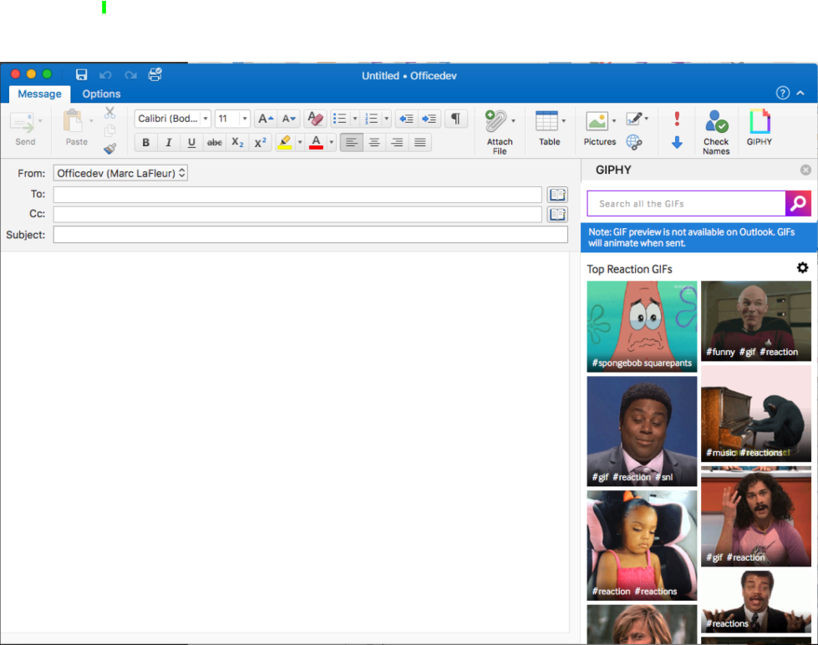
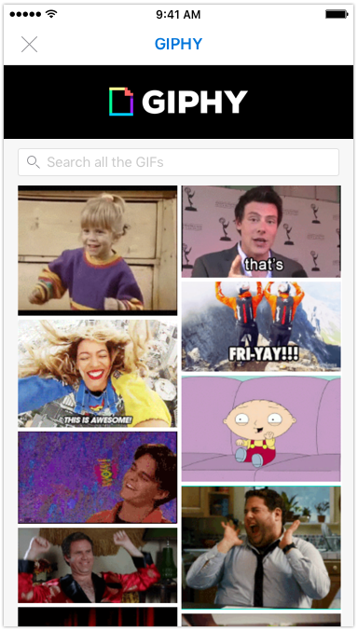

Cross Platform Example

Slide 24






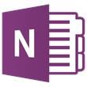
Microsoft Graph API
trendingAround
Shared with me
createdBy
CONVERSATIONS
public
manager
USER
workingWith
directReports
EVENTS
trendingAround
modifiedBy
TASKS
FILES
memberOf
workingWith
TASKS
GROUPS
createdBy
NOTES
NOTES
MESSAGES
FILES

Slide 25
Microsoft Graph API
Modern Web API using REST, OAUTH and JSON
Support for both Personal (MSA) and Work/School (AAD) Accounts
Aggregates multiple product APIs across Microsoft
Microsoft Graph API is where all Microsoft APIs will surface in the future
Your App
https://graph.microsoft.com
Users
Groups
Excel
Outlook
Calendar
OneNote
Teams
Planner
Intune
Azure AD
SharePoint

Slide 26
Calling the API
HTTP verbs dictate the request intent: GET | POST | PATCH | PUT | DELETE
Version: /v1.0 or /beta
Resource: /users, /groups, /sites, /drives, /devices, more…
Member from collection: /users/AAA
Property: /users/AAA/department
Traverse to related resources via navigations: /users/AAA/events
Query parameters: /users/AAA/events?$top=5
Format results: $select | $orderby
Control results: $filter | $expand
Paging: $top | $skip | $skiptoken
https://graph.microsoft.com
/{version}
/{resource}
/{id}
/{property}
?{query-parameters}

Slide 27
Graph Explorer Demo

Slide 28
Broad Platform Support
.NET
Ruby
Python
UWP
JavaScript
Angular
Xamarin
Android
iOS
ASP.NET MVC

Slide 29
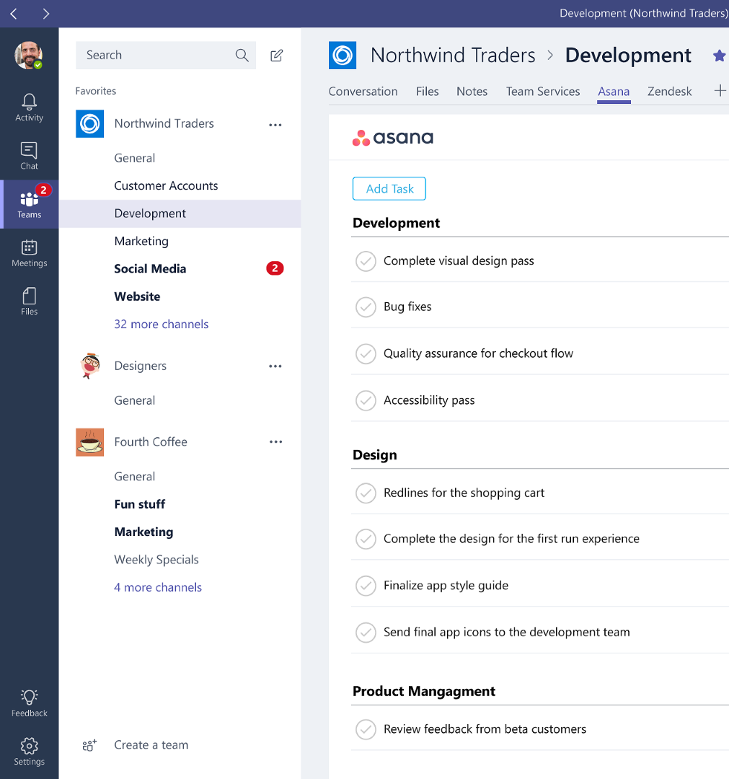
Microsoft Teams Extensibility
Bots
Supports any bot using Microsoft Bot Framework
Support 1:1 and Channel interactions
Connectors
Same Connectors used by Outlook and Modern Groups
Compose
Extends the existing composition area
Tabs
Apps
Embedded web application
Includes APIs for interacting with Teams client
Configured by Channel
Bundled bots, tabs, connectors and compose extensions packaged as a single application
Activity Feed
Surfaces application notifications directly within the Teams activity feed
Conical example would be inserting a GIF

Slide 30
Microsoft Teams Demo

Slide 31
Resources
Office Dev Center https://dev.office.com/
Microsoft Graph Docs https://developer.microsoft.com/graph/
Microsoft Teams Dev Center
https://msdn.microsoft.com/Microsoft-teams/
Office Store https://store.office.com

Slide 32
Modern Workplace
M365 – Defense in Depth Overview

Slide 33

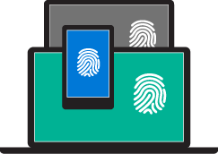
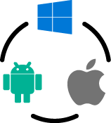
Microsoft Modern Work Place – Microsoft 365
Customers wants
Security against new threats
User freedom
Do more with less
Identity – driven security
Productivity without compromise
Comprehensive solutions
Microsoft solution
Microsoft Modern Work Place – M365
Notes:
Mobility tools are often point solutions that address specific security needs, but even multiple point solutions are still disconnected from one another, leaving cracks. Microsoft believes you should have an integrated mobility solution that provides security across multiple layers. You should have a comprehensive set of tolls that use identity as a control plane, provide the visibility and insights required to quickly pinpoint and resolve issues or threats, and simplify mobile device and application management.
Identity-driven security. Microsoft simplifies identity management by creating a single set of credentials for each worker, making it easier for IT to apply identity-based security measures, including conditional access policies and multi-factor authentication. Identity based security reporting, auditing, and alerting offer greater visibility so you can spot potential issues. 200+ days. That’s the average amount of time that attackers reside within your network until they are detected, gathering classified data and information, waiting to strike at just the right moment. Microsoft helps you identify breaches and threats using behavioral analysis and provides a clear, actionable report on a simple attack timeline.
Managed mobile productivity. Encourage your workers to use secure applications for work — even on personal devices — by providing the Office tools they know and love. Management capabilities built into Office make it easier for IT to protect company information. Conditional access policies restrict actions such as copy, paste, edit, and save —ensuring that workers only access corporate files through approved, managed apps and not personal workarounds where information can be corrupted or leaked. Nobody manages Office better than Microsoft. Sharing is a mainstay of collaboration for the mobile workforce, but poses a serious challenge to security. Microsoft gives you another integrated approach to information protection with a layer of security at the file level. Encryption, rights management, and authorization policies can be applied to any file type and remain with the data, wherever it goes and even in motion. Only authorized users can access protected files, and only on the sender’s terms.
Comprehensive Solution: Meet new business challenges with the flexibility of a cloud-first mobility solution. Microsoft cloud services are designed to work seamlessly with your on-premises infrastructure and existing investments. Stay ahead of your BYOD workers with rapid release cycles to support the latest devices and apps. Scale quickly to onboard new hires, devices, apps, and more. It’s fast, it’s cost-effective, and it’s always up-to-date. Manage across multiple OS types (iOS, Android, Windows) and thousands of cloud apps.

Slide 34
Solution Trigger Conversation / Words
Customers says
Prevent documents from being emailed or opened
How to I make device logins more secure
Need to manage and deploy device and keep them secure
Modern Work Place – M365
Identity – driven security
Productivity without compromise
Comprehensive solutions
Microsoft solution
Identity-driven security
Managed mobile productivity
Comprehensive solution
Notes:
Mobility tools are often point solutions that address specific security needs, but even multiple point solutions are still disconnected from one another, leaving cracks. Microsoft believes you should have an integrated mobility solution that provides security across multiple layers. You should have a comprehensive set of tolls that use identity as a control plane, provide the visibility and insights required to quickly pinpoint and resolve issues or threats, and simplify mobile device and application management.
Identity-driven security. Microsoft simplifies identity management by creating a single set of credentials for each worker, making it easier for IT to apply identity-based security measures, including conditional access policies and multi-factor authentication. Identity based security reporting, auditing, and alerting offer greater visibility so you can spot potential issues. 200+ days. That’s the average amount of time that attackers reside within your network until they are detected, gathering classified data and information, waiting to strike at just the right moment. Microsoft helps you identify breaches and threats using behavioral analysis and provides a clear, actionable report on a simple attack timeline.
Managed mobile productivity. Encourage your workers to use secure applications for work — even on personal devices — by providing the Office tools they know and love. Management capabilities built into Office make it easier for IT to protect company information. Conditional access policies restrict actions such as copy, paste, edit, and save —ensuring that workers only access corporate files through approved, managed apps and not personal workarounds where information can be corrupted or leaked. Nobody manages Office better than Microsoft. Sharing is a mainstay of collaboration for the mobile workforce, but poses a serious challenge to security. Microsoft gives you another integrated approach to information protection with a layer of security at the file level. Encryption, rights management, and authorization policies can be applied to any file type and remain with the data, wherever it goes and even in motion. Only authorized users can access protected files, and only on the sender’s terms.
Comprehensive Solution: Meet new business challenges with the flexibility of a cloud-first mobility solution. Microsoft cloud services are designed to work seamlessly with your on-premises infrastructure and existing investments. Stay ahead of your BYOD workers with rapid release cycles to support the latest devices and apps. Scale quickly to onboard new hires, devices, apps, and more. It’s fast, it’s cost-effective, and it’s always up-to-date. Manage across multiple OS types (iOS, Android, Windows) and thousands of cloud apps.

Slide 35
Microsoft Modern Work Place – Enterprise Mobility +Security
Customers needs
DLP/ Data Protection
SaaS Monitoring
MultiFactor Authentication
Identity Protection
Identity Monitoring
Device Management
Protected Workstations
Application Management / Control
Modern Work Place – M365 – EM+S
Identity – driven security
Productivity without compromise
Comprehensive solutions
Microsoft solution
Advanced Threat Analytics
Cloud App Security
Azure Information Protection
Azure Active Directory Premium
Privileged Identity Management
InTune (MDM /MAM)
Windows 10 - Advanced Threat Protection
Anti-Spam / Anti-Malware
Windows Trust Boot
Notes:
Mobility tools are often point solutions that address specific security needs, but even multiple point solutions are still disconnected from one another, leaving cracks. Microsoft believes you should have an integrated mobility solution that provides security across multiple layers. You should have a comprehensive set of tolls that use identity as a control plane, provide the visibility and insights required to quickly pinpoint and resolve issues or threats, and simplify mobile device and application management.
Identity-driven security. Microsoft simplifies identity management by creating a single set of credentials for each worker, making it easier for IT to apply identity-based security measures, including conditional access policies and multi-factor authentication. Identity based security reporting, auditing, and alerting offer greater visibility so you can spot potential issues. 200+ days. That’s the average amount of time that attackers reside within your network until they are detected, gathering classified data and information, waiting to strike at just the right moment. Microsoft helps you identify breaches and threats using behavioral analysis and provides a clear, actionable report on a simple attack timeline.
Managed mobile productivity. Encourage your workers to use secure applications for work — even on personal devices — by providing the Office tools they know and love. Management capabilities built into Office make it easier for IT to protect company information. Conditional access policies restrict actions such as copy, paste, edit, and save —ensuring that workers only access corporate files through approved, managed apps and not personal workarounds where information can be corrupted or leaked. Nobody manages Office better than Microsoft. Sharing is a mainstay of collaboration for the mobile workforce, but poses a serious challenge to security. Microsoft gives you another integrated approach to information protection with a layer of security at the file level. Encryption, rights management, and authorization policies can be applied to any file type and remain with the data, wherever it goes and even in motion. Only authorized users can access protected files, and only on the sender’s terms.
Comprehensive Solution: Meet new business challenges with the flexibility of a cloud-first mobility solution. Microsoft cloud services are designed to work seamlessly with your on-premises infrastructure and existing investments. Stay ahead of your BYOD workers with rapid release cycles to support the latest devices and apps. Scale quickly to onboard new hires, devices, apps, and more. It’s fast, it’s cost-effective, and it’s always up-to-date. Manage across multiple OS types (iOS, Android, Windows) and thousands of cloud apps.

Slide 36
Identity anchors our approach to security
IDENTITY – DRIVEN SECURITY
Holistic
Identity-driven
Innovative
Intelligent
Addresses security challenges across users (identities), devices, data, apps, and platforms―on-premises and in the cloud
Offers one protected common identity for secure access to all corporate resources, on-premises and in the cloud, with risk-based conditional access
Protects your data from new and changing cybersecurity attacks
Enhances threat and anomaly detection with the Microsoft Intelligent Security Graph driven by a vast amount of datasets and machine learning in the cloud.

Slide 37

With mobility come new security challenges
More than 1,000 businesses affected by cyber attacks
Another major retailer hacked
Attacks have become organized, targeted, and persistent
The network perimeter has vanished
You want to have visibility and control in the cloud

Slide 38







Security landscape has changed
IDENTITY – DRIVEN SECURITY
Identity
Devices
Apps & Data
Shadow IT
Cloud apps
SaaS
Employees
Partners
Customers
Azure
Data breach
Identity breach
On-premises apps
Current defenses not sufficient
Transition to cloud & mobility
New attack landscape

Slide 39












Modern Work Place Microsoft 365 - Enterprise Mobility +Security
IDENTITY - DRIVEN SECURITY
Extend enterprise-grade security to your cloud and SaaS apps
Microsoft Cloud App Security
Microsoft
Intune
Azure Active Directory Premium
Manage identity with hybrid integration to protect application access from identity attacks
Azure Information Protection
Protect your data, everywhere
Protect your users, devices, and apps
Detect threats early with visibility and threat analytics
Microsoft
Advanced Threat Analytics
Notes:
Microsoft’s enterprise & security solutions provide a holistic framework to protect your corporate assets across, on prem, cloud and mobile devices
Advanced Threat Analytics helps IT detect threats early and provide forensic investigation to keep cybercriminals out
Azure Active Directory Premium security reports help identify risky log ins. That paired with Azure Active Directory Identity Protection gives IT the ability to automatically block access to apps based on real time risk scoring of identities and log ins.
Microsoft Cloud App Security provides deep visibility and control of data inside cloud applications
Microsoft Intune manages and secures corporate data on mobile devices and collaborated within corporate apps.
Azure Information Protection helps keep data secure and encrypted throughout a customers environment and extends security when data is shared outside the organization.

Slide 40

Mobile device, application, and information protection
MANAGED MOBILE PRODUCTIVITY
Manage and secure devices
Office mobile apps
Data-level protection
User self-service
Notes:
Protect your Office Mobile apps without compromising your Office experience: EMS is the only solution built with and for Microsoft Office. This means that email and other Office files can be secured without compromising the Office experience – the gold standard of productivity.
Enable easy access to resources: Sign in once for secure access to all corporate resources, on-premises and in the cloud, from any device. This includes pre-integrated support for Salesforce, Concur, Workday, and thousands more popular SaaS apps.
Enable users to protect and control data: Employees can encrypt virtually any type of file, set granular permissions, and track usage. With Office files, encryption can be applied with just one click. The encryption stays with the file where it goes, enabling more secure file sharing, internally and externally.
Empower users with self-service capabilities: Users can update passwords and join and manage groups via a single portal to help save your IT helpdesk time and money. This applies across all iOS, Android, and Windows devices in your mobile ecosystem.

Slide 41



Manage and secure mobile devices - InTune
MANAGED MOBILE PRODUCTIVITY
Access management
Built-in security
Gold standard
Conditional access
Device settings & Compliance enforcement
Multi-identity support
Mobile app management (w & w/o a device enrollment)
File level classification, labeling, and encryption
Office mobile apps
Familiar and trusted

Slide 42






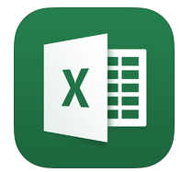
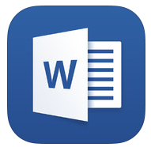










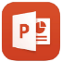









Mobile app management - InTune
MANAGED MOBILE PRODUCTIVITY
Multi-identity policy
Managed apps
Managed apps
Corporate
data
Managed apps
Email
attachment
Personal
data
Copy
Paste
Save
Paste to personal app
Save to personal storage
Personal apps
Personal apps
Personal apps
Notes:
If we take a closer look at our user’s newly enrolled device which is now compliant and ready to go, we can see that she is still able to maintain a personal experience on her device. She has organized her applications the way she wants, with all of her apps available on one screen.
She has her managed corporate apps—the Office mobile apps she knows and loves and personal apps that she uses outside of work and may even consider using these personal apps to try to boost her productivity at work. Even though our user has all of her apps at hand on her personal device, IT is able to enjoy unparalleled management of the Office mobile apps, so that with Microsoft Intune, our IT pro has a different perspective on the organization of our user’s personal device. With the new multi-identity management feature, you an enable users to access both their personal and work accounts using the same Office mobile apps while only applying the MAM policies to their work account – providing a seamless experience while employees are on-the-go.
For our IT pro, there is still a clear separation of the managed corporate apps and our user’s personal apps. But, this doesn’t affect the user’s access to apps. By applying policy at the app level, our IT pro can support mobile productivity while maintaining user preferences, and still have the ability to protect corporate data and resources with the Intune-managed Office mobile apps.
The Intune App Wrapping Tool also allows IT to apply similar policies to your existing line-of-business applications so that these resources are equally protected through the organization’s proprietary apps. You can enable users to securely view content on devices within your managed app ecosystem using the Managed Browser, PDF Viewer, AV Player, and Image Viewer apps for Intune as well.
Let’s now take a closer look at how app-level policies can help keep company data and information secure. Our user receives a work email through her managed Outlook account with an attached Excel spreadsheet containing information she needs for a report. Our user opens the attachment in her Excel mobile application to find the information she needs. She then wants to copy the info to add to her report.
But when she tries to paste it into her personal notepad, it doesn’t work—the personal notepad is not a managed app and our IT pro has applied policies that restrict copy, paste, and cut functions to only apps that are part of the managed app ecosystem (for Intune enrolled devices). So our user opens her Microsoft Word mobile app which is managed by Intune and she is successfully able to paste her information. Now our user wants to save the working copy of her report to her personal OneDrive account so that she can access it from her home computer.
Because her personal OneDrive account is not one of the managed applications, she’s unable to save it here. IT has applied policies restricting the ability to save to only apps that are part of the managed app ecosystem.
So our user must save her working copy to her managed OneDrive for Business account, which means when she does want to work on this report from another device, this device will have to be an enrolled for management . By using the mobile application management capabilities of Intune, the IT pro can help prevent leakage of important company data and make sure that this information doesn’t get into the wrong hands.

Slide 43

Classify and label data based on sensitivity – Azure Information Protection
MANAGED MOBILE PRODUCTIVITY
IT admin sets policies,
templates, and rules
STRICTLY CONFIDENTIAL
CONFIDENTIAL
FINANCE
INTERNAL
CONFIDENTIAL
NOT RESTRICTED
Classify data according to policies – automatically or by user
Add persistent labels defining sensitivity to files

Slide 44
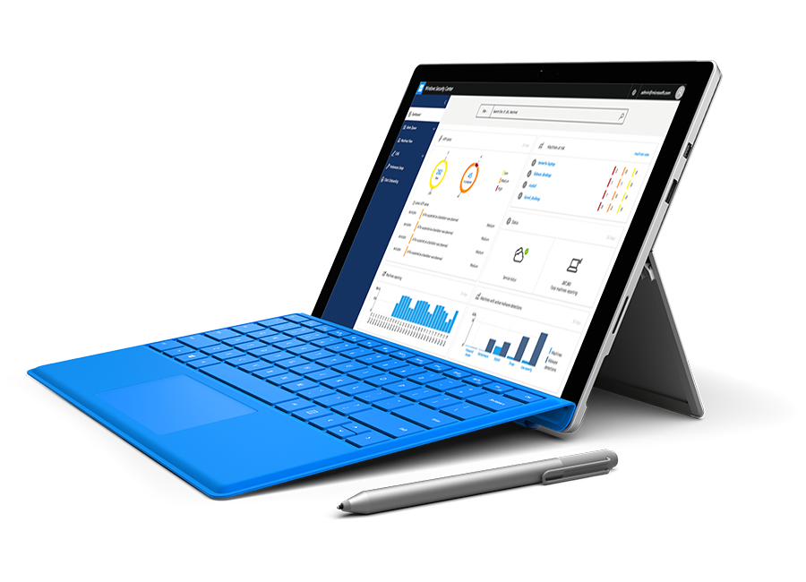
WINDOWS DEFENDER
ADVANCED THREAT PROTECTION
DETECT ADVANCED ATTACKS AND REMEDIATE BREACHES
Built into Windows, cloud-powered
No additional deployment & Infrastructure. Continuously
up-to-date, lower costs.
Behavior based, post-breach detection Actionable, correlated alerts for known and unknown adversaries. Real-time and historical data.
Rich timeline for investigation
Easily understand scope of breach. Data pivoting across endpoints. Deep file and URL analysis.
Unique threat intelligence knowledge base Unparalleled threat optics provide detailed actor profiles
1st and 3rd party threat intelligence data.

Slide 45



Flexible architecture that just works
COMPREHENSIVE SOLUTION
Always up to date
Works with what you have
Simple to set up and connect
Real-time updates
Keep up with new apps and devices
Support multiple platforms
Use existing investments
Easy, secure connections
Simplified management

Slide 46
Enterprise Mobility + Security
Identity and access management
Managed mobile productivity
Information
protection
Identity-driven
security
Azure Active Directory Premium P2
Identity and access management with advanced protection for users and privileged identities
(includes all capabilities in P1)
Azure Information Protection Premium P2
Intelligent classification and encryption for files shared inside and outside your organization
(includes all capabilities in P1)
Microsoft Cloud App Security
Enterprise-grade visibility, control, and protection for your cloud applications
EMS
E5
Azure Active Directory Premium P1
Secure single sign-on to cloud and on-premises apps
MFA, conditional access, and advanced security reporting
Microsoft Intune
Mobile device and app management to protect corporate apps and data on any device
Azure Information Protection Premium P1
Encryption for all files and storage locations
Cloud-based file tracking
Microsoft Advanced Threat Analytics
Protection from advanced targeted attacks leveraging user and entity behavioral analytics
EMS
E3

Slide 47
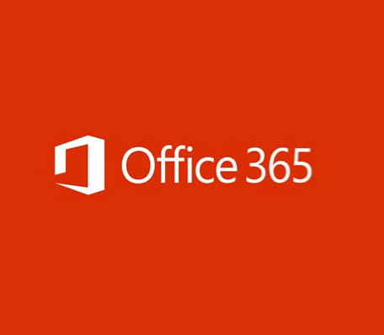
Complementary to EMS and Office 365
App security
Identity-driven security
Cross-SaaS
Complements EMS
Microsoft Cloud App Security
Provides cross-SaaS app security
Discovery for 13,000 apps and risk scoring- no agents
Ongoing assessment and analytics for all discovered apps
Cross-cloud controls for creating and enforcing policies, DLP, and data sharing
Alerts for threat detection for supported and all discovered apps
Microsoft Cloud App Security
Complements EMS by providing enterprise-grade security for cloud apps
Discovery for 13,000 apps and risk scoring—no agents needed
Ongoing assessment and analytics for all discovered apps
Cross-cloud controls for creating and enforcing policies, DLP, and data sharing
Alerts for threat detection for supported and all discovered apps
Only Office 365-related capabilities embedded into Office 365 Security and Compliance Center
Discovery for apps with similar functionality to O365
App permissions and control
Alerts for anomaly detection
Built rich DLP features integrated into Office DLP
Enterprise Mobility Suite
Comprehensive solution for mobility, identity, and security
Azure AD Premium provides shadow IT discovery, identity, and access management
Advanced Threat Analytics provides threat protection on-premises with behavioral analysis
Azure Rights Management provides encryption, identity & authorization to secure data
Microsoft Intune provides MDM/MAM capabilities to protect corporate apps and data almost on any device

Slide 48

© 2015 Microsoft Corporation. All rights reserved. Microsoft, Windows, Windows Vista and other product names are or may be registered trademarks and/or trademarks in the U.S. and/or other countries.
The information herein is for informational purposes only and represents the current view of Microsoft Corporation as of the date of this presentation. Because Microsoft must respond to changing market conditions, it should not be interpreted to be a commitment on the part of Microsoft, and Microsoft cannot guarantee the accuracy of any information provided after the date of this presentation. MICROSOFT MAKES NO WARRANTIES, EXPRESS, IMPLIED OR STATUTORY, AS TO THE INFORMATION IN THIS PRESENTATION.

